Slide 1
Lost in Hollywood: The Evolution of Space on the Big Screen
By: Haley Huson

Slide 2
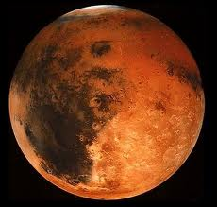
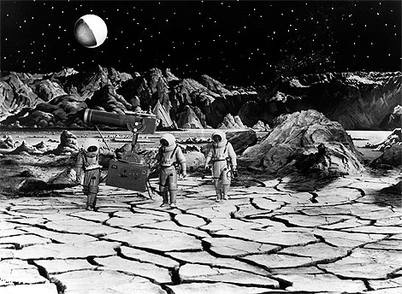
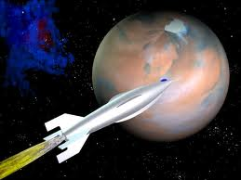
The 1950’s
Flight to Mars
Destination Moon
The moon’s surface has many craters but isn’t cracked like seen here.
To the right: A picture of Mars. The density is <1% of Earth’s allowing us to see its rough surface.
To the left: A still from the movie. Here the size ratio is off and mars has a much lighter color to it.

Slide 3
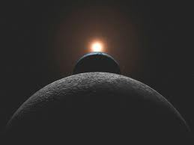
The 1960’s
2001: A Space Odyssey
Considered one of the most accurate sci-fi movies of all time.
Here we see the moon, earth, and sun aligned. The size and distance ratio is wrong.
Journey to the 7th Planet
A mission sends men to explore the planet Uranus.
Problem: Uranus is made up of gases
No surface for them to explore
Movie Playing*

Slide 4
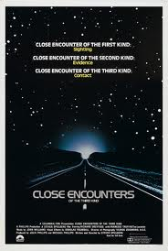
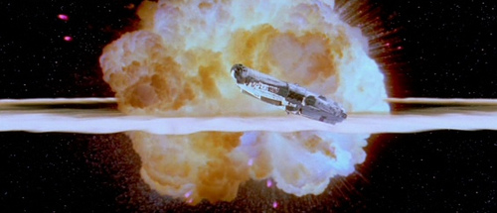
The 1970’s
Close Encounters of the Third Kind
Star Wars IV: A New Hope
No Oxygen=No Explosion
Common mistake in Hollywood.

Slide 5
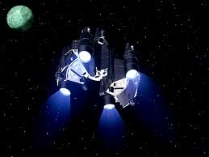
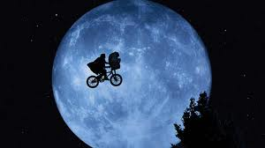
The 1980’s
E.T. Extra Terrestrial
More believable picture.
Apparent size.
The Last Starfighter

Slide 6
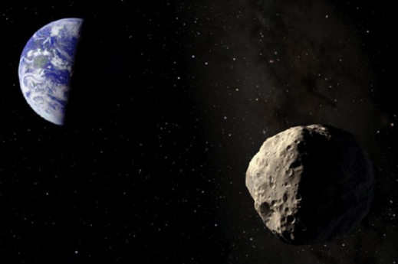
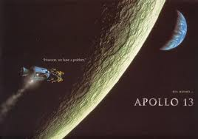
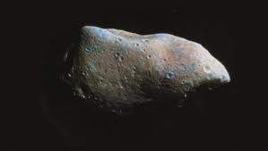
The 1990’s
Apollo 13
Moon goes through phases in 4 days.
Normal moon phases take 28 days.
Armageddon
Most inaccurate movie
To the Left: From Armageddon, round asteroid the size of Texas (~1400 km)
To the Right: Ceres, the largest asteroid, ~940 km and irregularly shaped

Slide 7
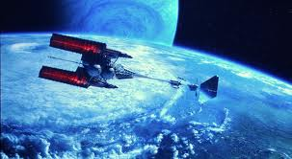
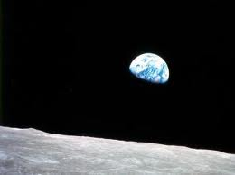
The 2000’s
Avatar
Apollo 18
Today’s movies are more realistic, though they are still riddled with technical difficulties in engineering.

Slide 8
Most Common Mistakes
Size Ratios
Apparent Size
Moon Phases
Sound
Explosions
Replications

