Slide 1
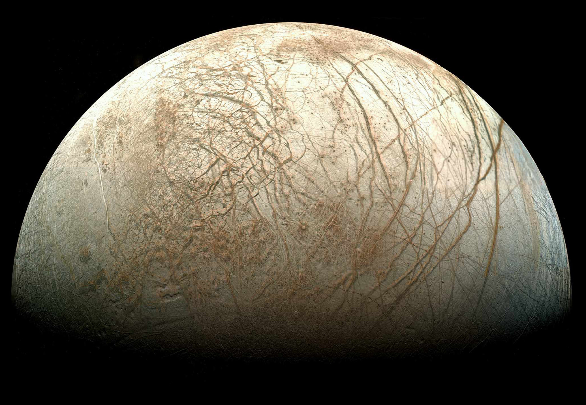
The Hidden Ocean of Europa: Exploring a Potentially Habitable World
Robert Pappalardo
Jet Propulsion Laboratory
California Institute of Technology
liquid water
essential elements
chemical
energy
stable environment
[Mosaic by T. Stryk]
Copyright 2014 California Institute of Technology. Government sponsorship acknowledged.

Slide 2
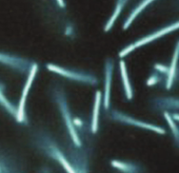
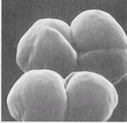
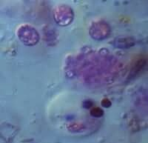
Some Reactions That Can Power Life
Photosynthesis (plants):
CO₂ + H₂O → sugar + O₂
Aerobic respiration (animals):
sugar + O₂ → CO₂ + H₂O
Iron oxidation:
2Fe²⁺ + ¹/₂ O₂ + 2H⁺ → 2Fe³⁺ + H₂O
Methanogenesis:
CO₂ + 4H₂ → CH₄ + 2H₂O
Sulfur reduction or oxidation:
H₂SO₄ + 4H₂ → H₂S + 4H₂O
CO₂ + 2H₂S → CH₂O + 2S + H₂O
Chemosynthesis: Chemical reactions that can power life, in the absence of sunlight (without photosynthesis).
Notes:
Fe(2+) is oxidized because it loses an electron.

Slide 3
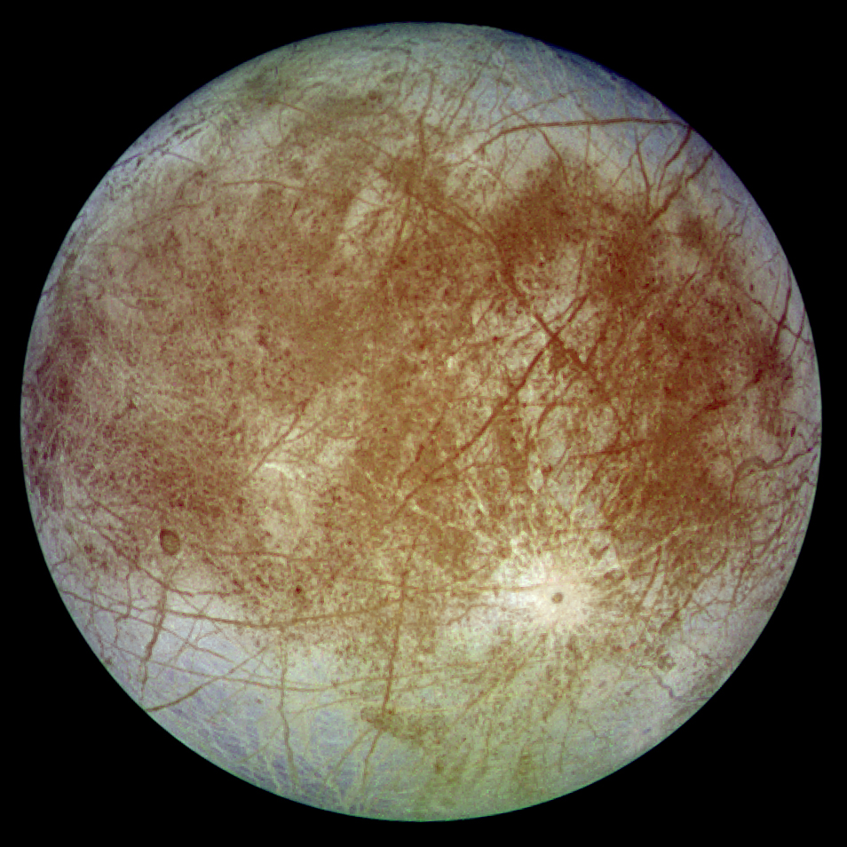
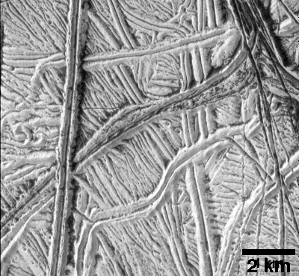
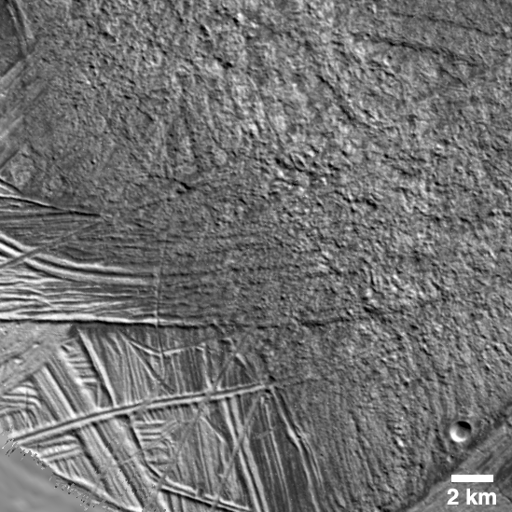
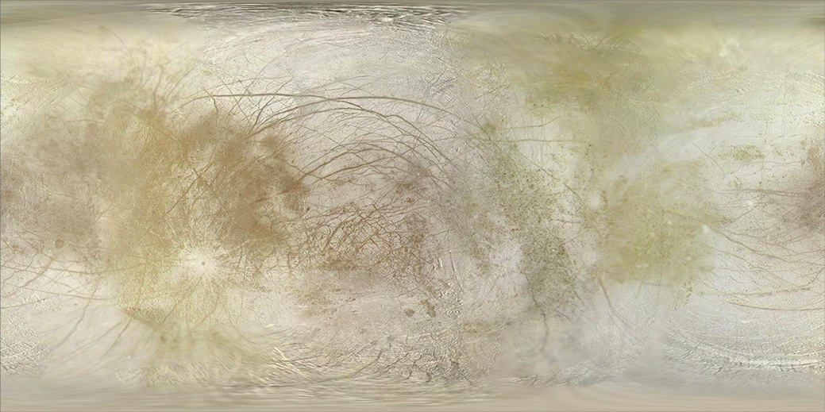
Europa’s Enigmatic Geology
ridged plains
chaotic terrain
Notes:
3

Slide 4
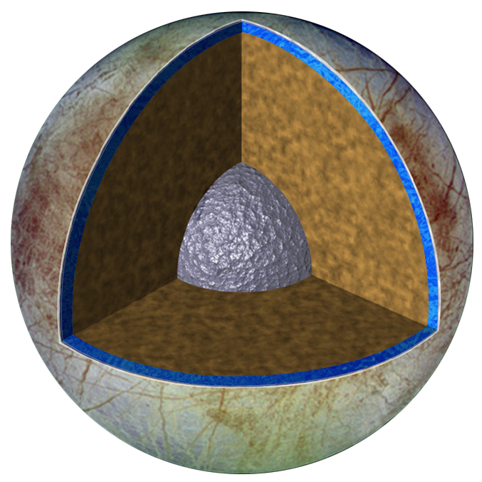
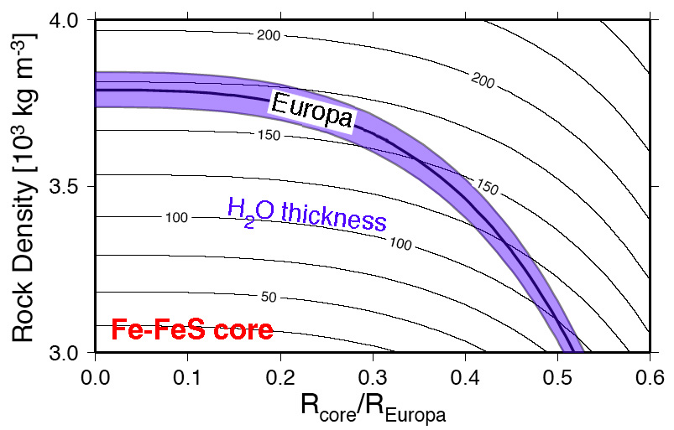
Europa’s Differentiated Interior
Axial moment of inertia from Doppler gravity data:
C/MR² = 0.346
H₂O-rich crust: ~80 – 170 km thick
[Anderson et al., 1998]

Slide 5
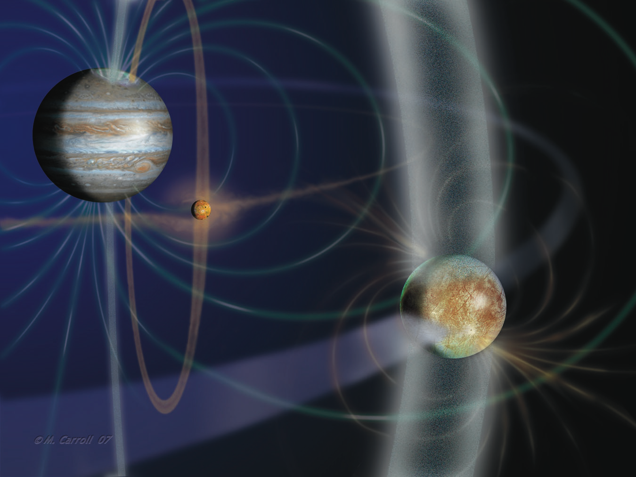
Europa’s Magnetic Field
Art by Michael Carroll

Slide 6
Europa’s Induced Magnetic Field
orbit plane
mag. equator
field line at Europa
vector at Europa
[animation by E. Sturm using JET]
Galileo E14
ocean induction model
observed
[Schilling et al., 2007]
no induction model

Slide 7
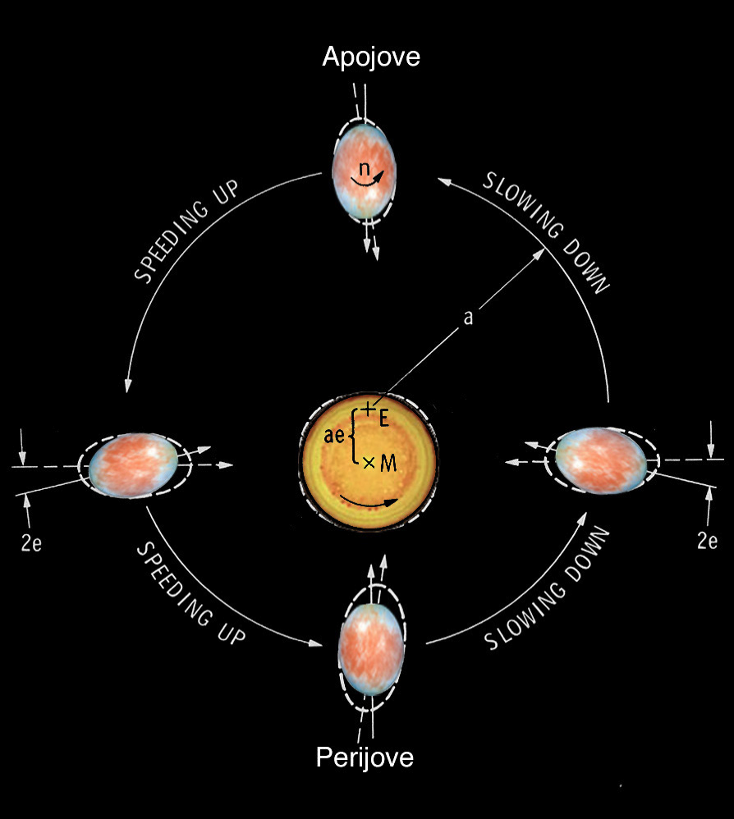
Europa’s Eccentric Orbit
For an eccentric satellite orbit, permanent bulge faces empty focus
Radial tide of ~30 m for Europa if ice shell is decoupled by ocean
Tidal bulge librates to face Jupiter’s center of mass
Tidal deformation dissipates energy ⇒ tidal heating
Misaligned tidal bulge and ice thickness variations promote nonsynchronous rotation
P = 85 hr
e = 0.01
not to scale
permanent bulge
[after Nash et al., 1982]
variable tidal bulge

Slide 8
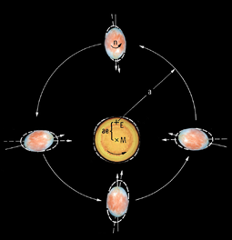
Tidal Flexing ⇒ Tidal Heating
Eccentric orbit raises ~30 m tide above a global ocean.
Tidal heating of warm (softest) ice, and perhaps mantle.
Notes:
8

Slide 9
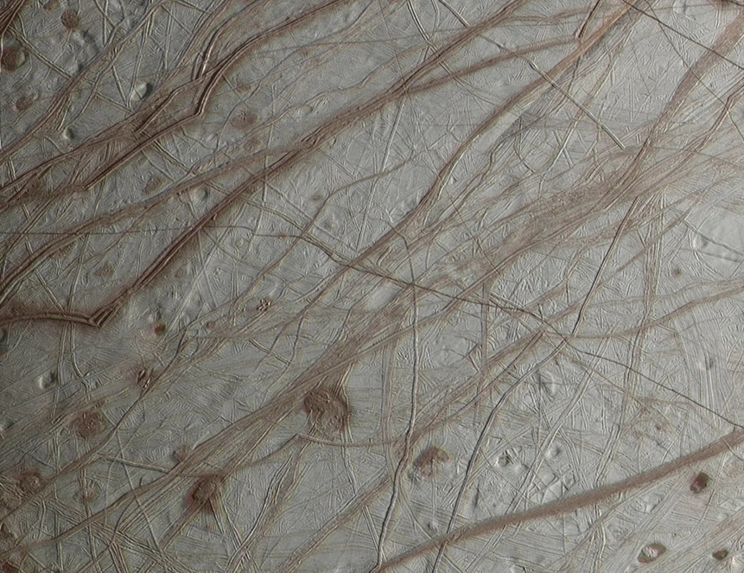
Ridges
Mosaic by Orion

Slide 10
Diurnal Stresses
180°
0°
Tension
Compression
0.2 MPa

Slide 11
Cycloidal Fractures
Latitude
rotating diurnal stresses
[Hoppa et al., 1999]
Longitude
Cycloidal fractures are explained by time-varying diurnal stresses
Ocean is necessary for sufficient tidal amplitude and stress

Slide 12
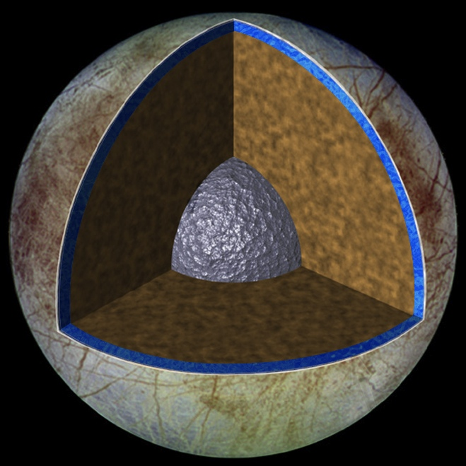
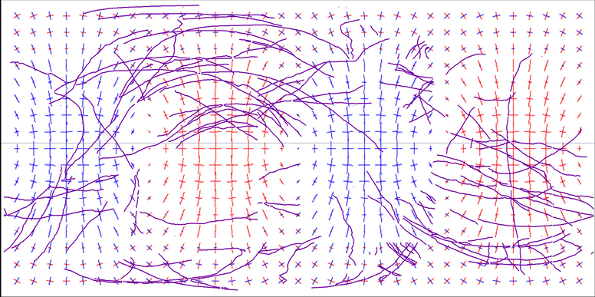
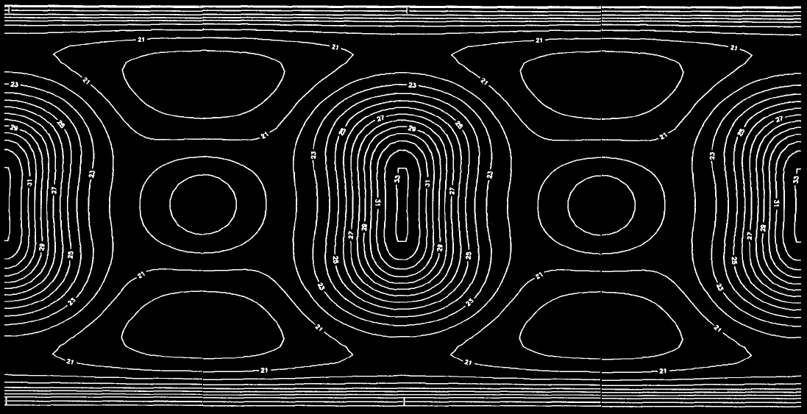
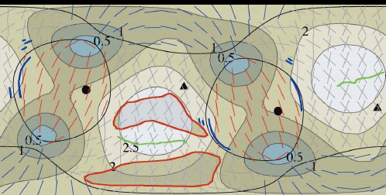
Global Stress Mechanisms
Nonsynchronous Rotation (NSR)
Ice Shell Thickness Prediction
0.5 MPa
[courtesy Z. Selvans]
Tension
Compression
True Polar Wander (TPW)
[Ojakangas & Stevenson, 1989]
Temperature and strain rate affect ice shell thickness
Thickness variations promote promote reorientation of globally decoupled ice shell
[Schenk et al., 2007]

Slide 13
Ridge Morphology

Slide 14
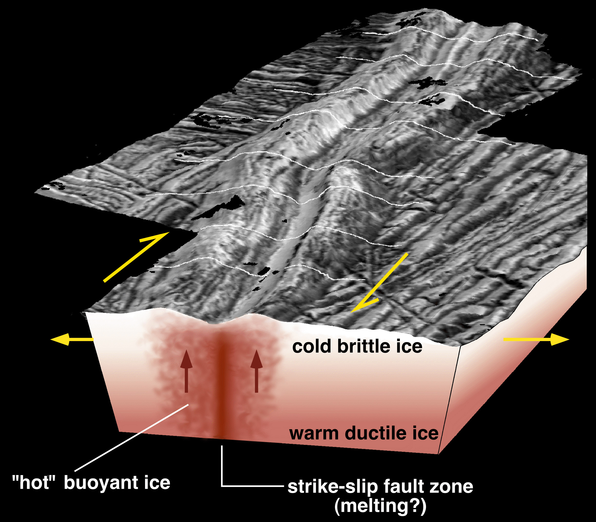
Ridge Models
shear heating
Double ridges: extrusion or intrusion of water or warm ice
Shear heating from strike-slip motion along fractures could warm and melt ice
Ridge origin models have different implications for ocean communication
diking
Notes:
14

Slide 15
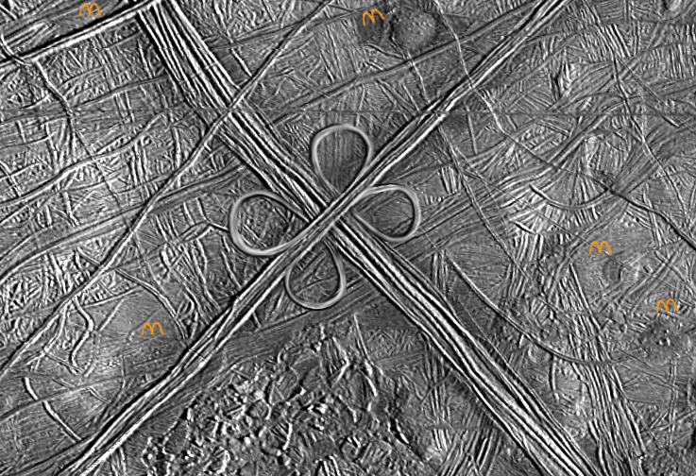
L.A. Model for Europa’s Ridges

Slide 16
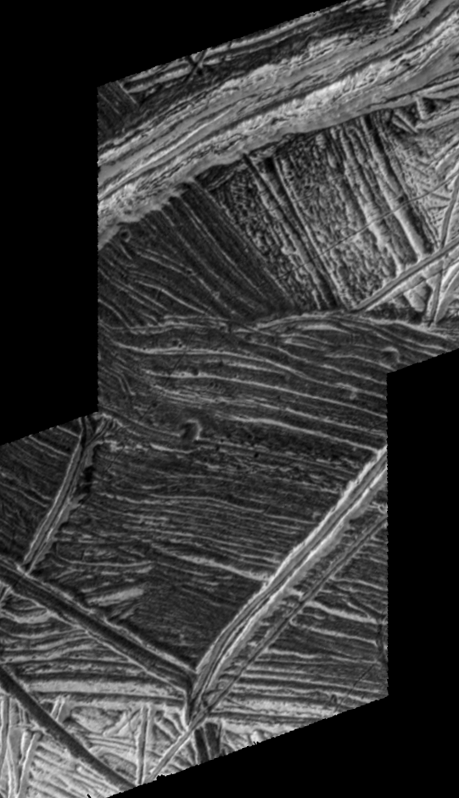
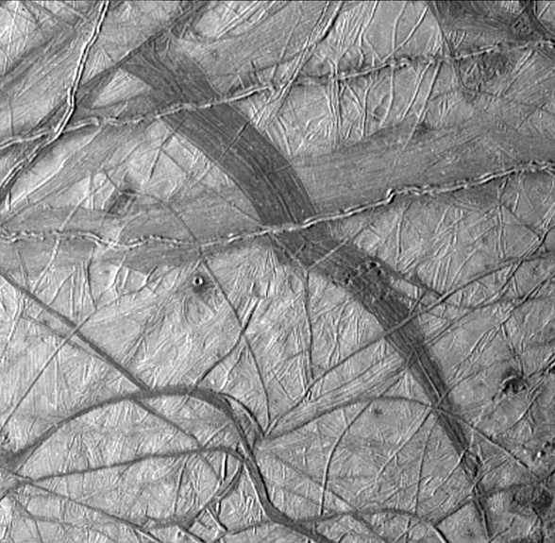
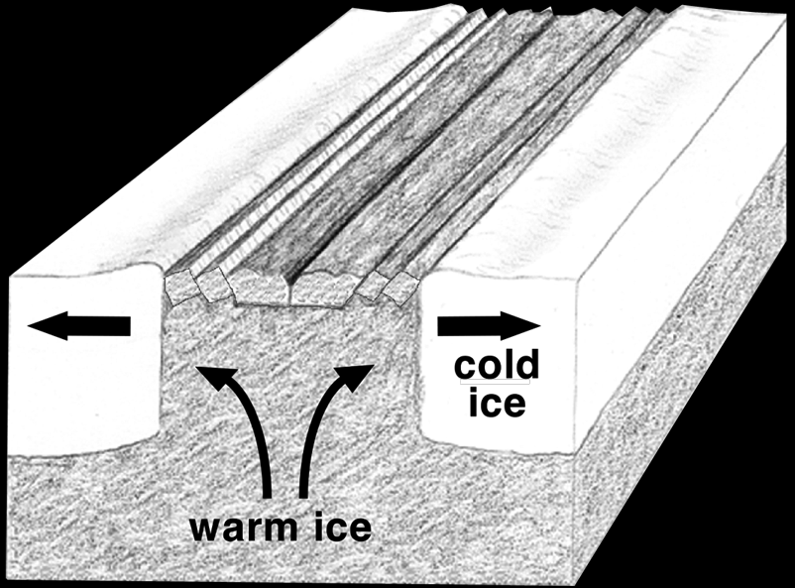
Bands
Sites of full separation and spreading of icy lithosphere
Icy spreading center analogs
Thin brittle “lithosphere” translates above ductile ice “asthenosphere”
Yelland Linea
[courtesy L. Prockter]

Slide 17
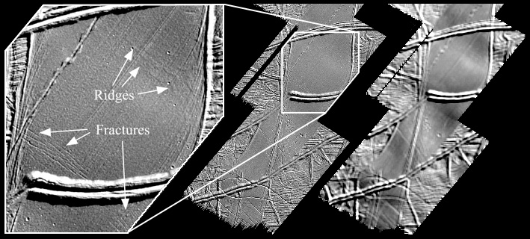
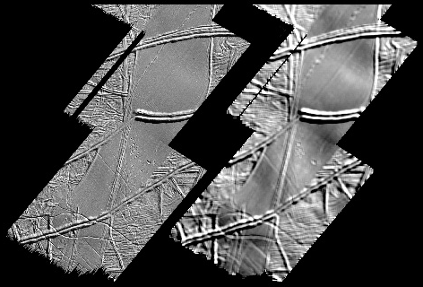
Regional-Scale Folds
Astypalaea region (and elsewhere); wavelengths ~20-25 km.
Viscous buckling of lithosphere above warmer ductile ice.
Lithosphere thickness ~2.5-3 km; heat flow ~100 mW/m².
Strain ≥ ~0.025% (parallel folds) to ~2% (vertical strain).
[Prockter & Pappalardo, 2000]

Slide 18
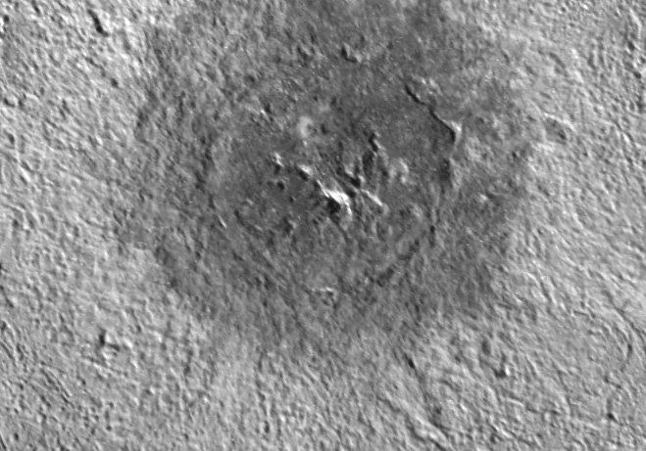
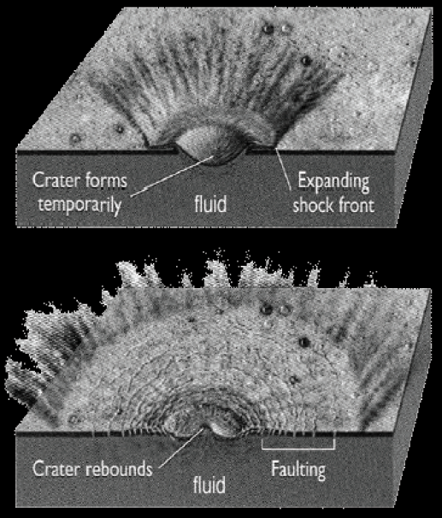
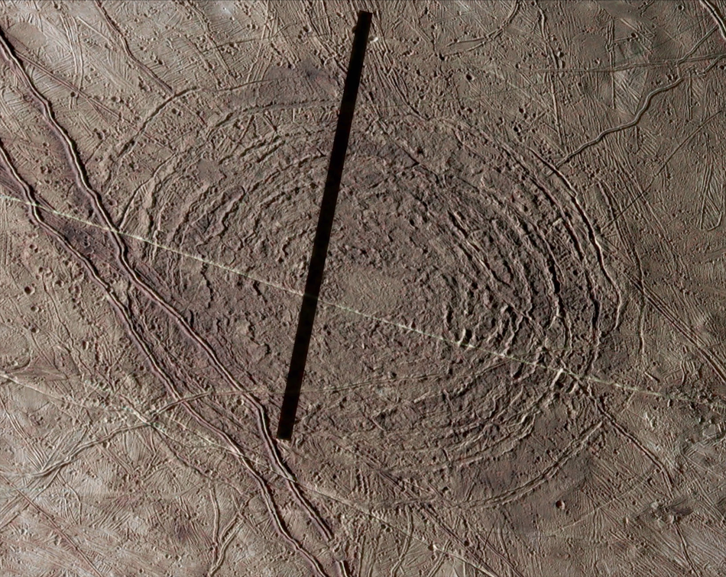
Impact Structures
Few large impact craters imply 40–90 Myr old surface
Central peak craters show “relaxed” topography
Multi-ringed impacts penetrated ≈20 km thick ice
Pwyll
Tyre
d _{t}
after
McKinnon
& Melosh,
[1980]
D_{c} ~ 30 km ⇒ d_{t} ~ 20 km [Schenk, 2002]
Notes:
18

Slide 19
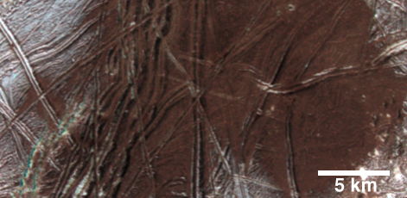
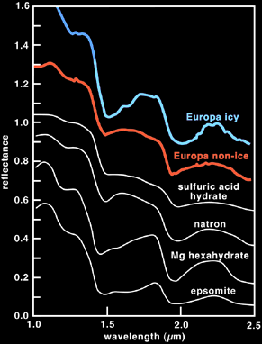
Surface Composition
[after Dalton et al., 2005]
“Non-ice” material shows shallow and asymmetric IR absorptions
Best candidates:
Hydrated sulfates salts (epsomite: MgSO₄ • 7H₂O)
Hydrated sulfuric acid (H₂SO₄ • nH₂O)

Slide 20
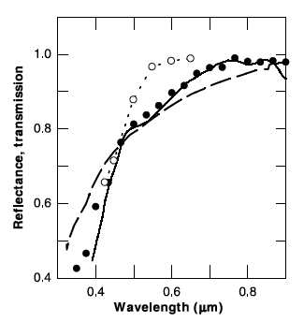
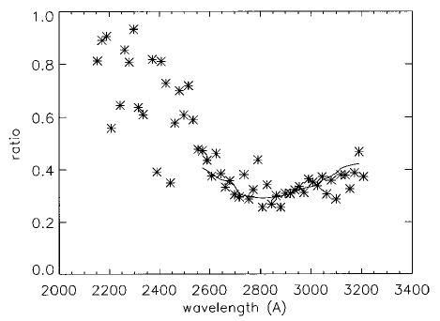
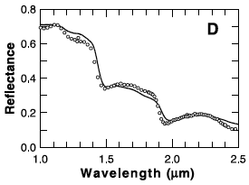
Proposed Radiolytic Sulfur Cycle
irradiated
SO₂
Europa
irradiated
H₂S + H₂O
SO₂-irradiated
H₂O
Visible: S_{x}
IR: H₂SO₄•8H₂O
UV: SO₂
[Carlson et al., 1999]

Slide 21
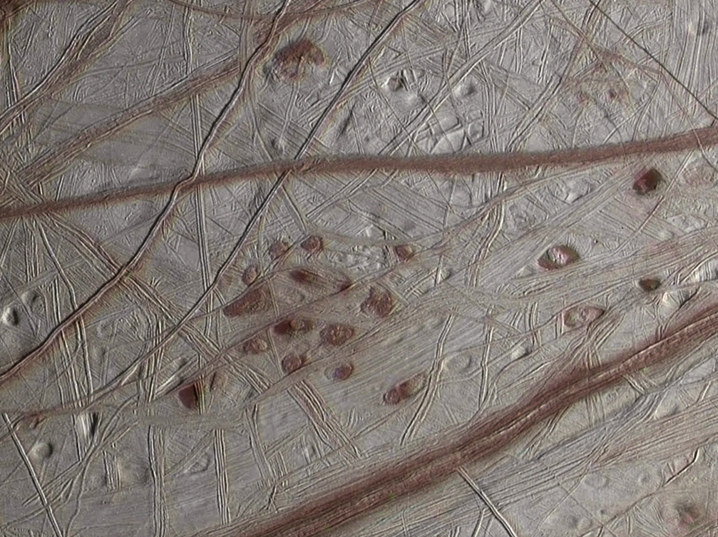
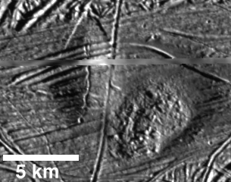
Lenticulae (“Freckles”)
Mosaic by Orion

Slide 22
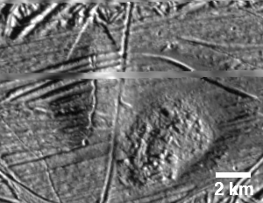
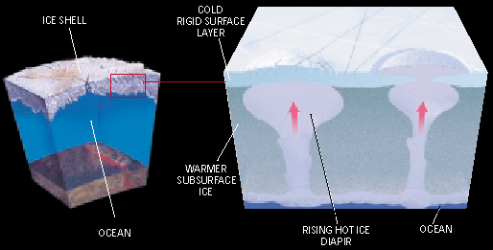
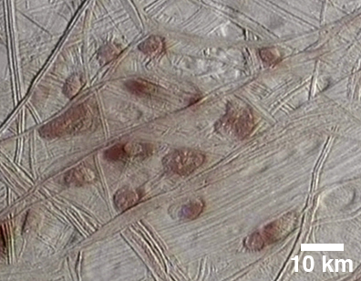
Convection in Europa's Ice Shell
Pits, spots, and domes suggest convection of ice shell.
Ice shell can convect for small grain sizes (~1 mm), if tidally strained.
Warm (~240 K) plumes rise from base of ice in ~10⁵ yr.
Compositional buoyancy needed to breach near-surface “stagnant lid.”
~ 100 K
~ 260 K
[Ice convection model courtesy A. Barr]
Notes:
22

Slide 23
Journey to Conamara Chaos

Slide 24
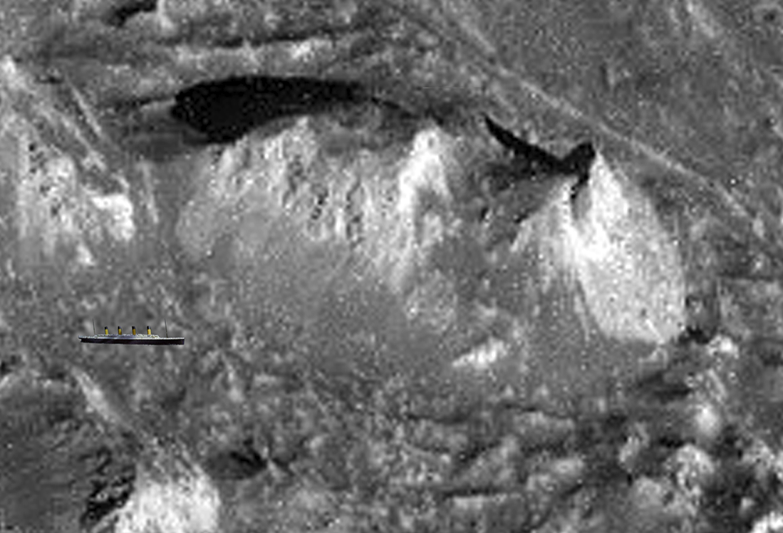
Icebergs?
300 m

Slide 25
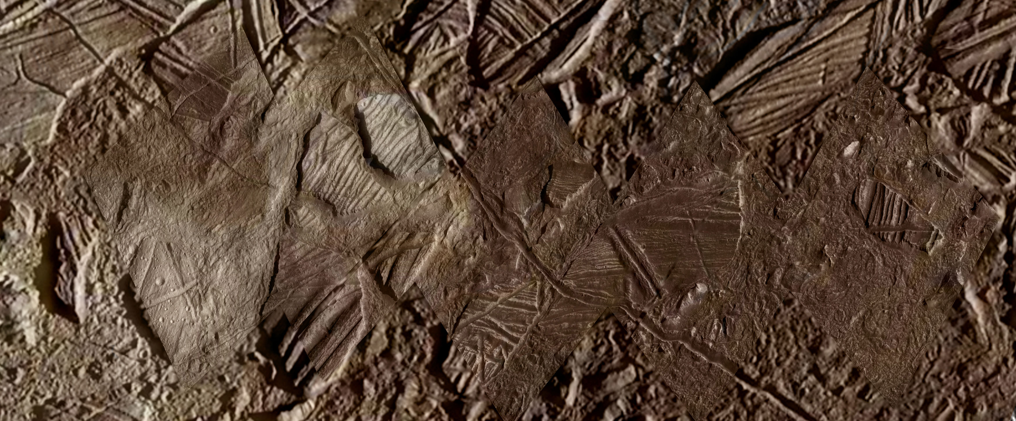
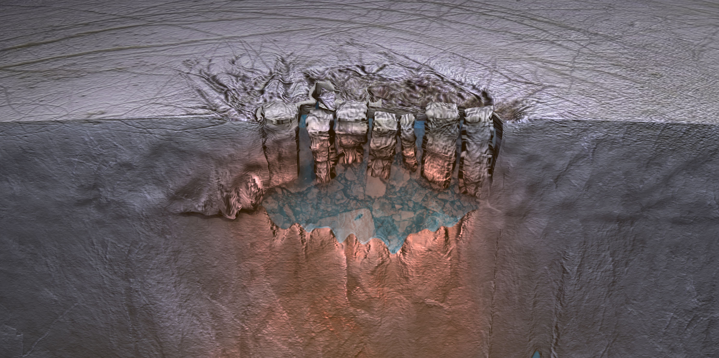
Chaos
Conamara
[mosaic by Orion]
Thera
Lake Model
20 km
[Schmidt et al., 2000]

Slide 26
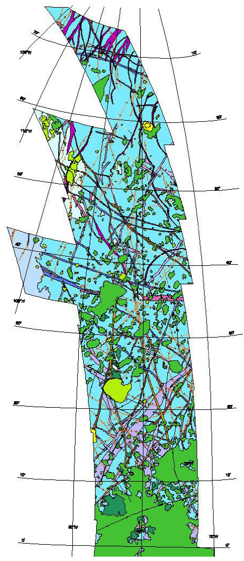
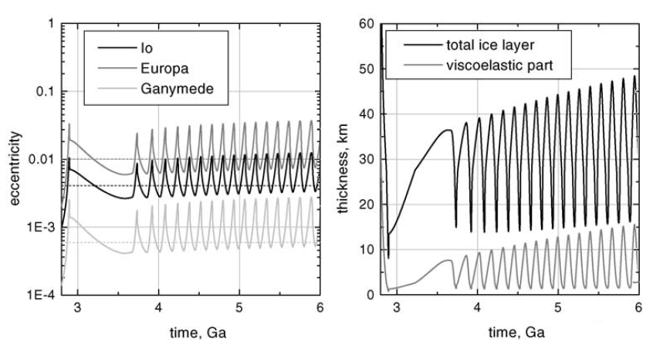
Cyclical Geological Activity?
Mapping suggests geological changes:
Transition from ridged plains to chaos; waning activity
Strange for a surface just ~40–90 Myr old!
Tidal heating and orbital evolution of the 3 resonant Galilean satellites are linked:
Possible cyclical tidal heating & geological activity
Coupled orbits
Europa ice thickness
[Hussmann et al., 2004]
[Figueredo & Greeley, 2004]

Slide 27
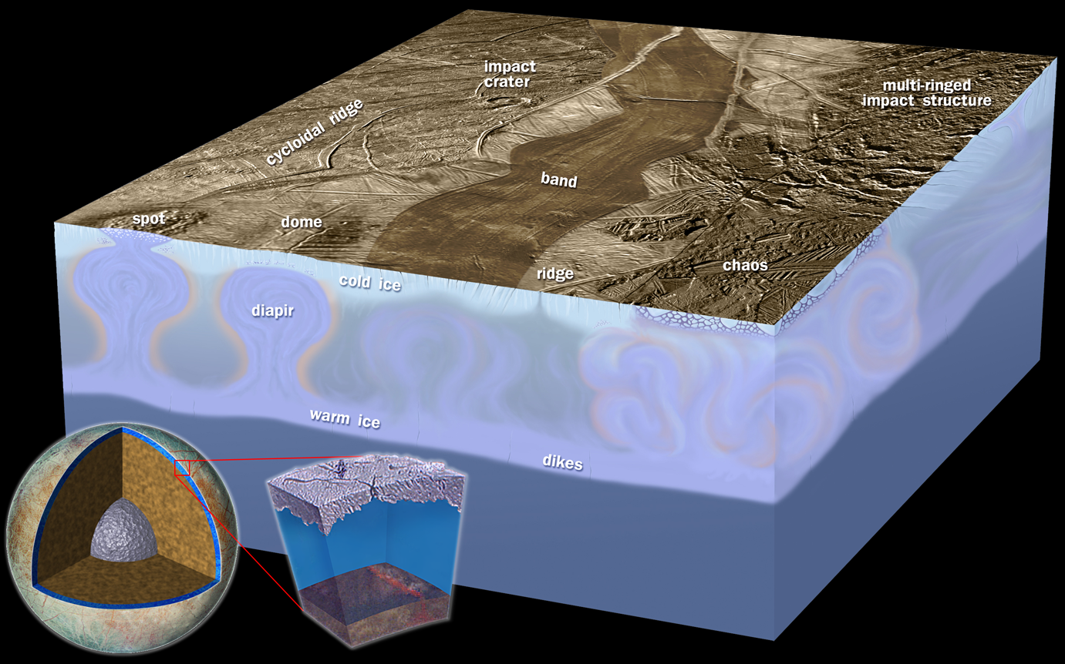
Summary Model
Warm ice shell with partial melting above global ocean.
Notes:
27

Slide 28
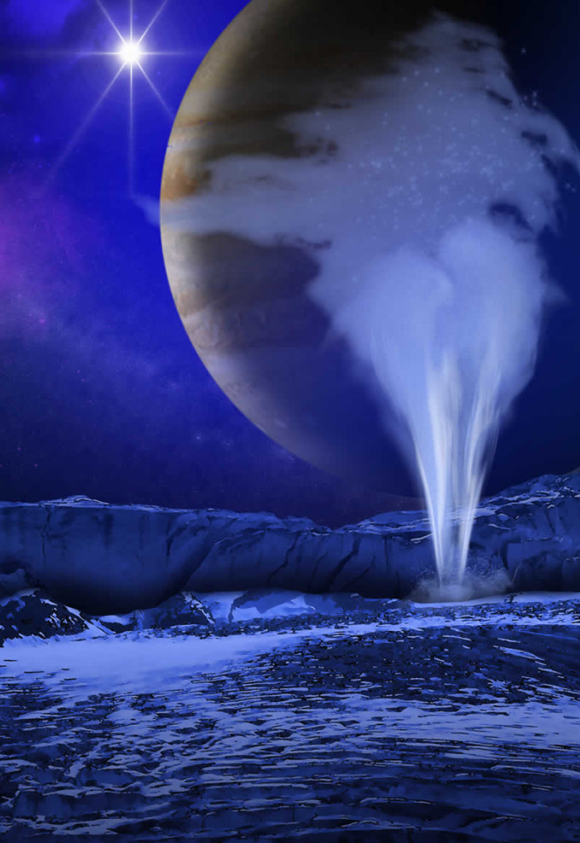
Europa Plumes
Hydrogen glow
Hubble has observed hydrogen and oxygen ultraviolet glow, ~200 km above Europa
Indicates water plumes!
Previously suspected but not observed
May be transient, perhaps linked to Europa's tidal cycle
Source may be the ocean, a lake within the ice, or perhaps warm shallow ice
If confirmed, plumes imply:
Europa is currently geologically active
Europa's native composition could be directly sampled from a capable flyby spacecraft
Lorenz et al. 2013
Artist’s depiction

Slide 29
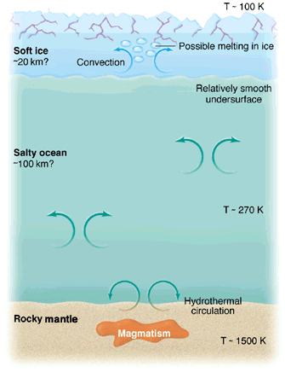
Europa: Ingredients for Life?
e⁻, O⁺, S⁺, …
Water:
Warm salty H₂O ocean
Essential elements:
Accretion and impactors
But radiation destroys organics in upper ~10s cm of ice
Chemical energy:
Radiation of H₂O creates near-surface oxidants
Mantle contact: serpentinization and hydrothermal activity
Stable environment:
Large satellite retains heat
Activity level might fluctuate
radiation-produced oxidants: O₂, H₂O₂, CH₂O
hydrothermally produced reductants: H₂S, H₂, CH₄, Fe
[after Stevenson, 2000]

Slide 30
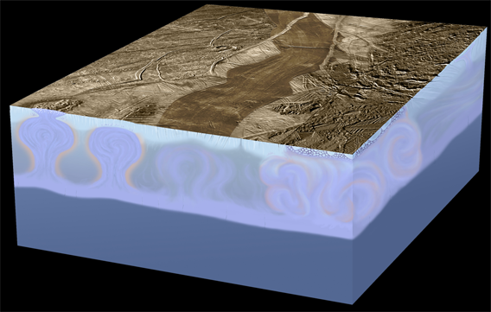
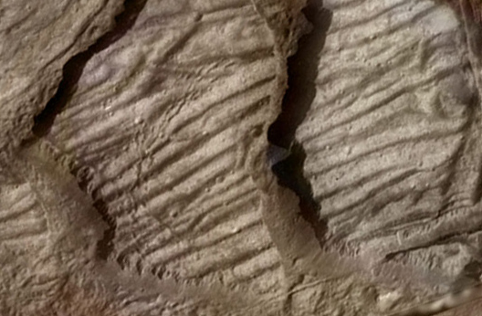
Planetary Science Decadal Survey
“The first step in understanding the potential of the outer solar system as an abode for life is a Europa mission with the goal of
• Confirming the presence of an interior ocean,
• Characterizing the satellite’s ice shell, and
• Enabling understanding of its geologic history”
Ocean
Ice Shell
Composition
Geology
A mission that is responsive to the Planetary Decadal Survey must enable comprehensive study of Europa addressing these objectives

Slide 31
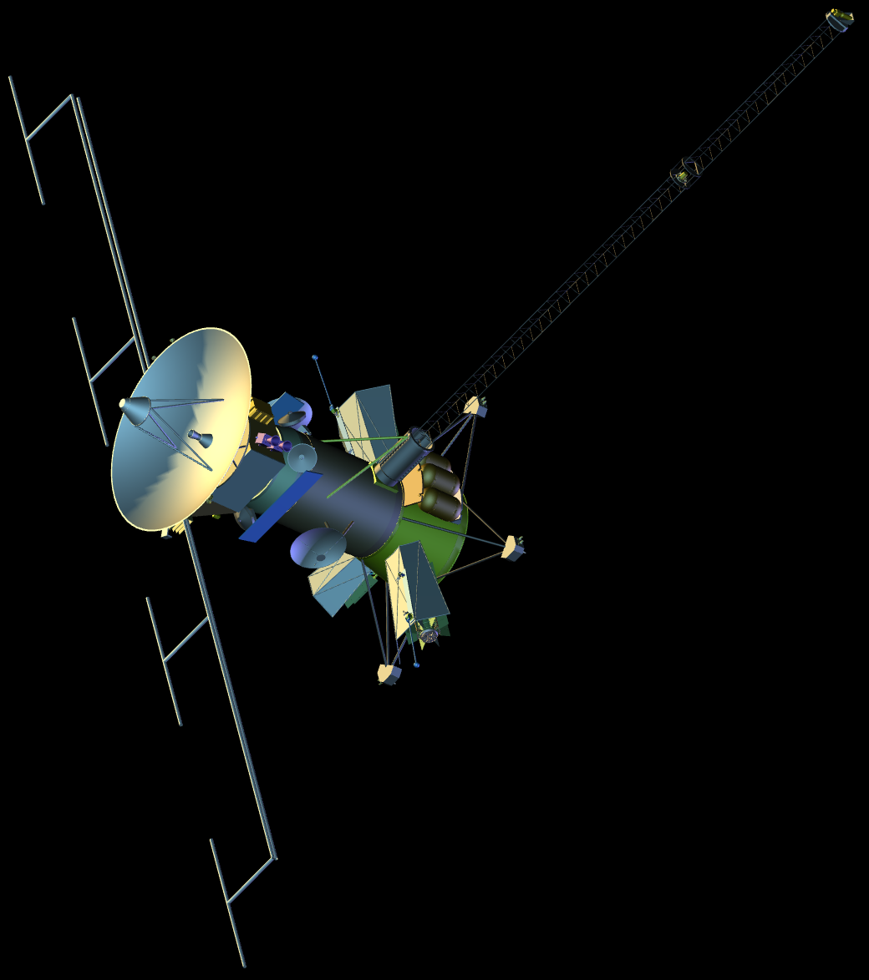
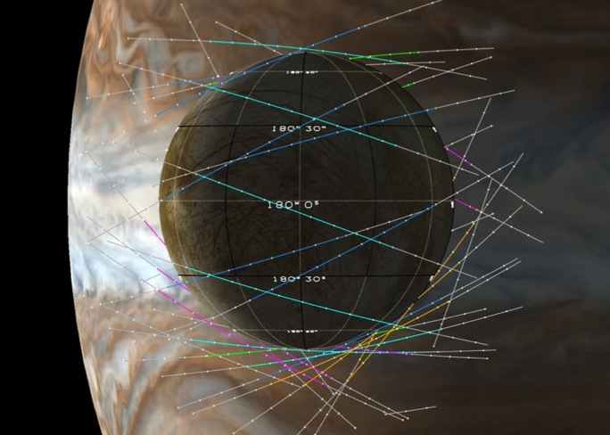
Europa Clipper Concept: Summary
Objectives:
Ocean: Existence, extent, salinity
Ice Shell: Water within or beneath; nature of surface-ice-ocean exchange
Composition: Key compounds; links to ocean composition
Geology: Surface feature formation; sites of recent or current activity
Reconnaisance: Surface characteristics at lander scales
Operations Concept:
45 low-altitude flybys from Jupiter orbit
Investigation of globally distributed regions
Simple and repetitive science operations
Minimal time in high radiation environment
Validated Cost Estimate:
Aerospace validated cost: $2.1B ($FY15, w/o LV)
Model Payload:
Ice-Penetrating Radar
Stereo Camera
Infrared Spectrometer
Neutral Mass Spectrometer
Gravity Science Antenna
Magnetometer & Langmuir Probes
Reconnaissance Camera
Thermal Imager
Notes:
Remove cost
Highlight changes

